Slide 1
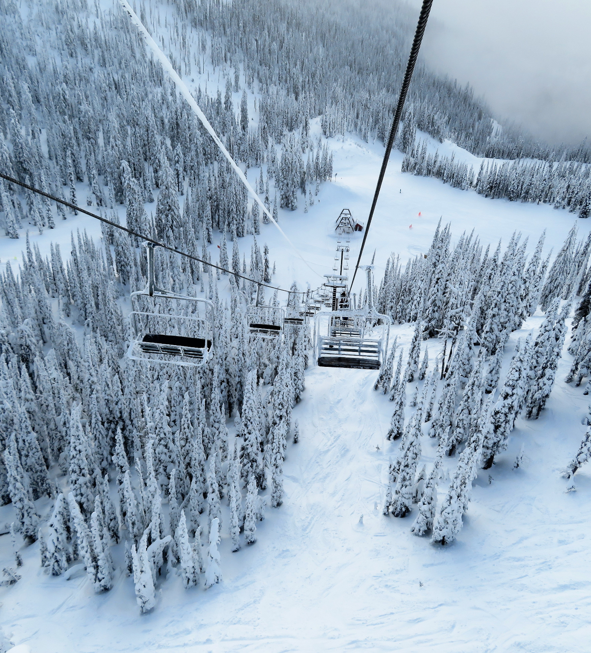
Big Mountain Resort
How can Big Mountain Resort implement a data-driven pricing strategy that will increase revenue and ticket value based on a targeted set of comparable competitors

Slide 2
Current State
Lift Ticket Price is set by charging a premium above average of market segment.
Newly installed chairlift will add $1.54 Million to operating expenses.
Current ticket price is set to $81
Estimated revenue at current price is $141.65 Million for the season
Under suspicion that the current pricing strategy may be leaving unrealized revenue on the table, Big Mountain Resort set an objective to redefine the lift ticket pricing to a data driven strategy that can illuminate insights on value, operational costs, and ultimately drive revenue.

Slide 3
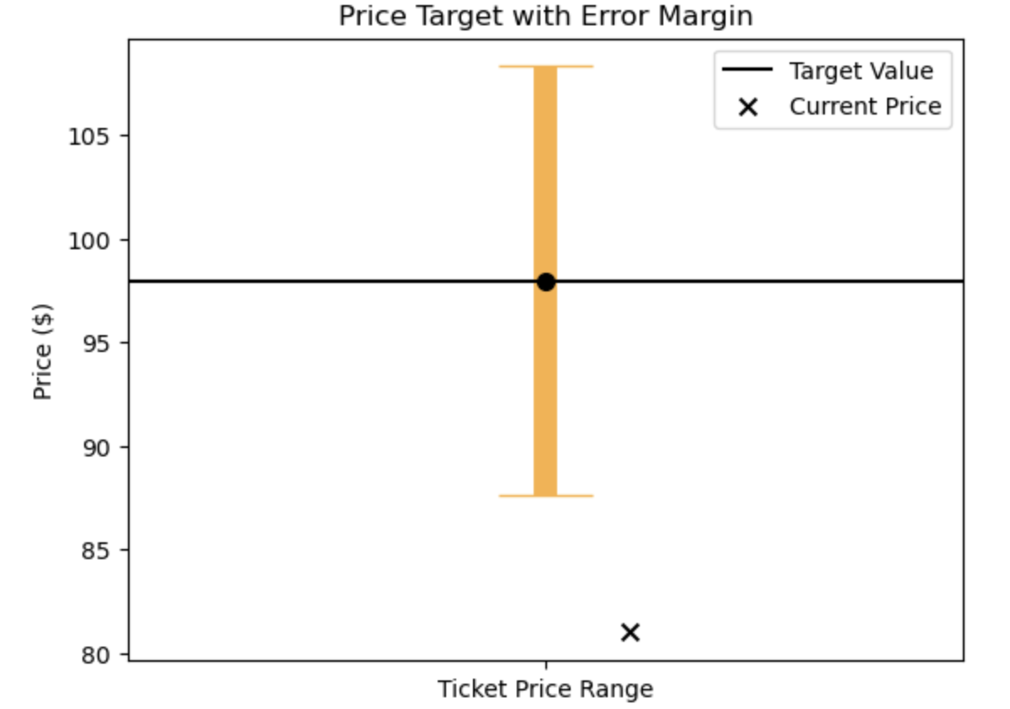
Recommendation
Using a machine-learning model trained on data from more than 300 ski resorts in the US, we have determined that Big Mountain Resorts lift tickets are currently underpriced and have room for growth.
Our Machine Learning Model set a price target of $97.96 with a error margin of $10.36.
Indicates ticket prices could be increased by $6.60 - $27.32 per ticket.
Full ticket price range set to $87.60 - $108.32
By adopting this model for a data driven pricing strategy, Big Mountain Resort could generate additional revenue by an an estimated $11.55M - $47.81 Million per season.

Slide 4
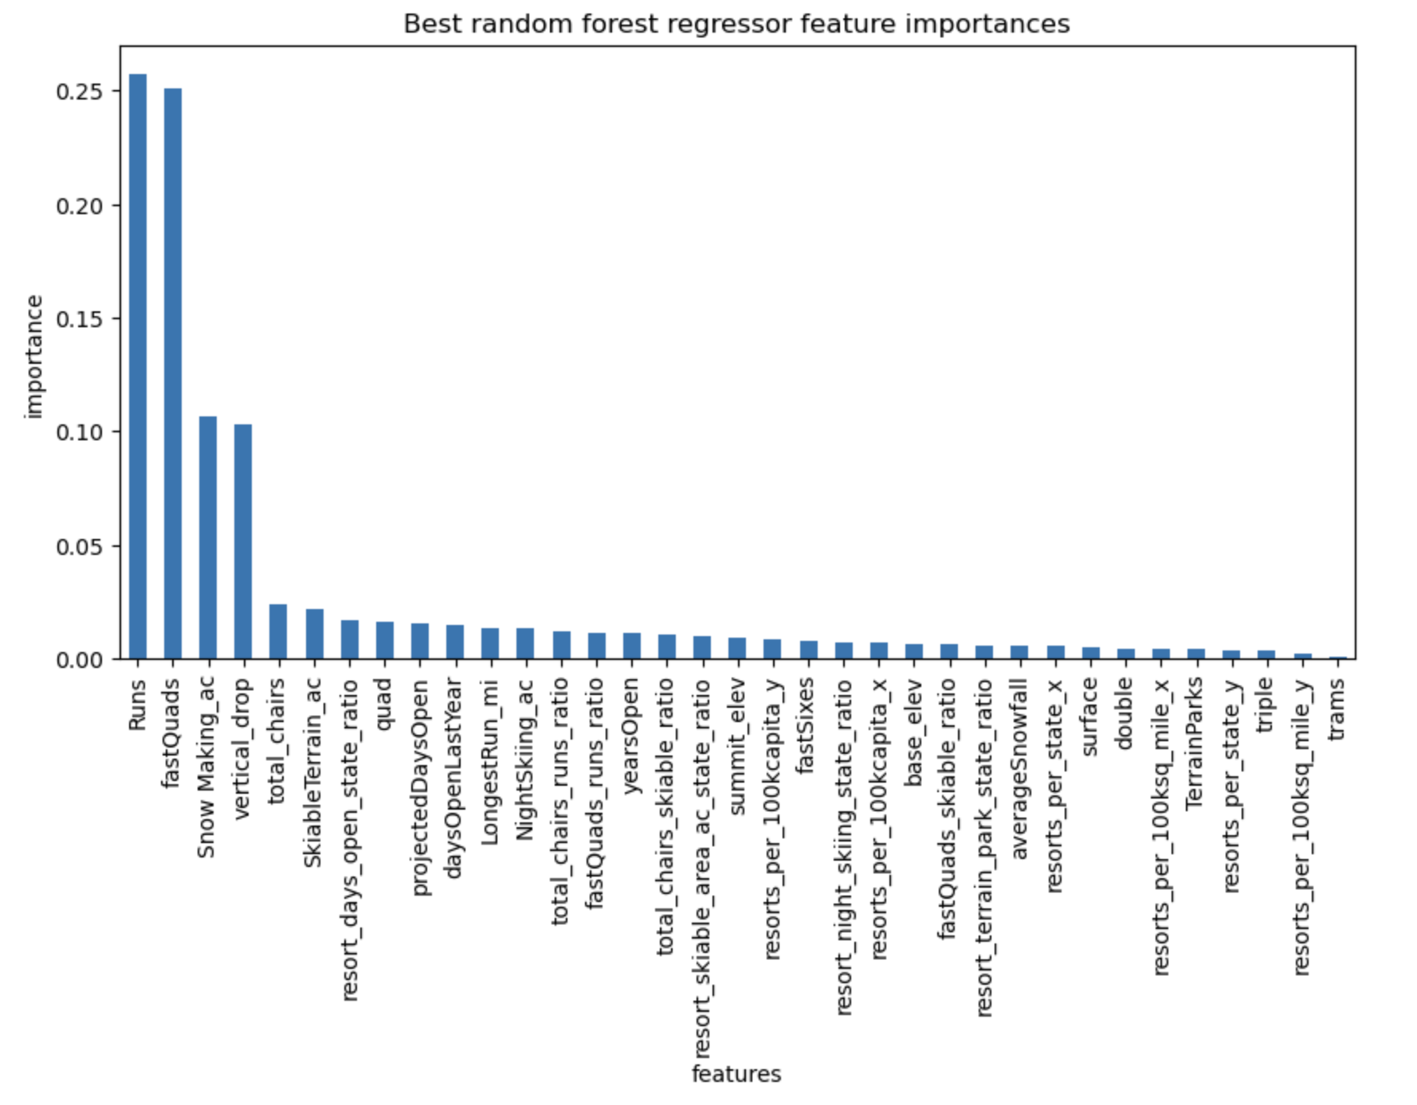
Data Analysis
While exploring the data of over 300 ski resorts in the United States, we use a process called scaling to determine key features that correlate to ticket price value.
These key features proved to drive ticket prices and value to a resort.
Top 4 Key Features
Number of Runs
Number of Fast Quad Chair Lifts
Snow Making acres
Total Vertical Drop

Slide 5
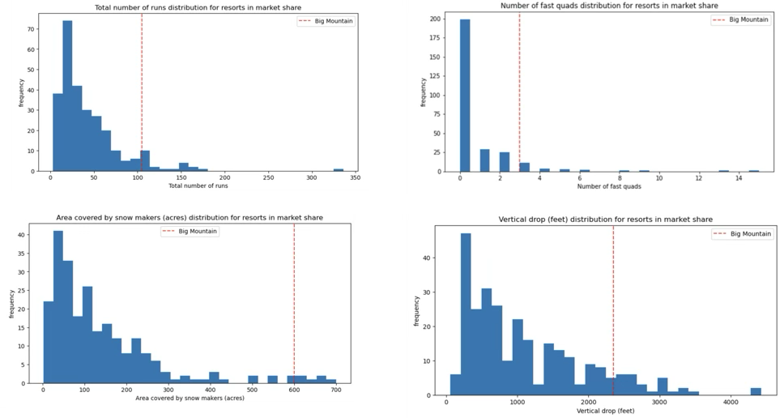
Data Analysis
When examining the top 4 key features present at Big Mountain Resort vs the other resorts in the US, we can see that Big Mountain was well above average in all categories

Slide 6
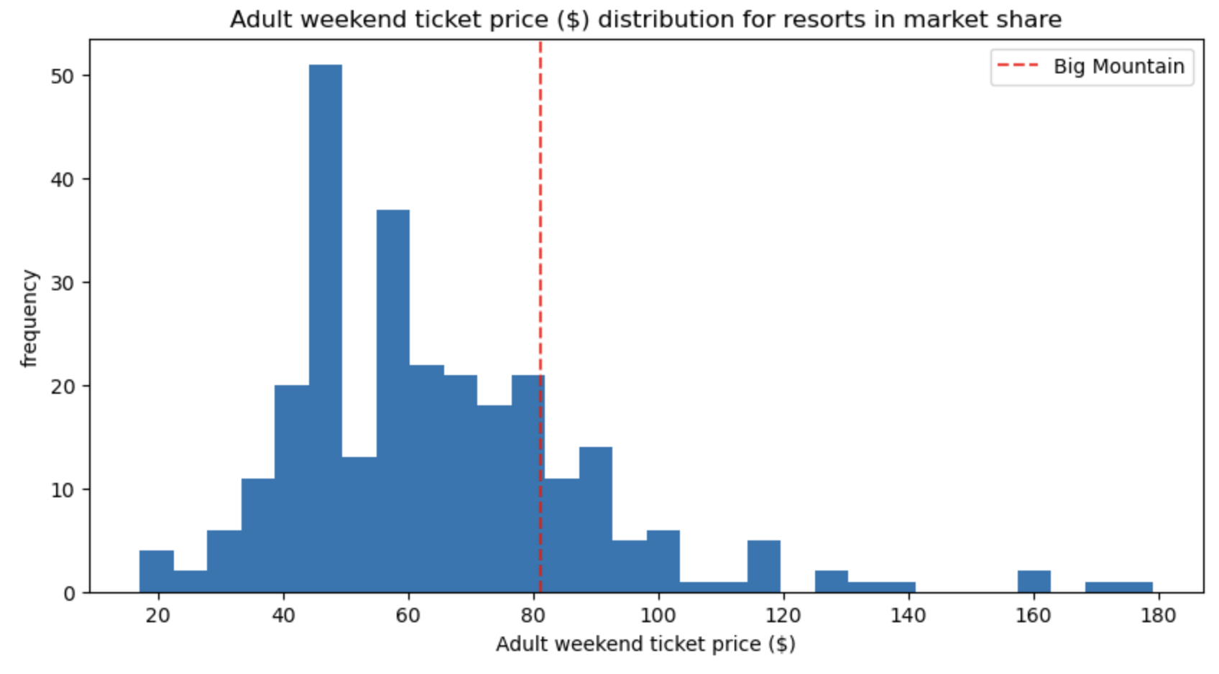
Data Analysis
We can also see that the current pricing at Big Mountain Resort is only slightly above average, leaving room for growth.

Slide 7
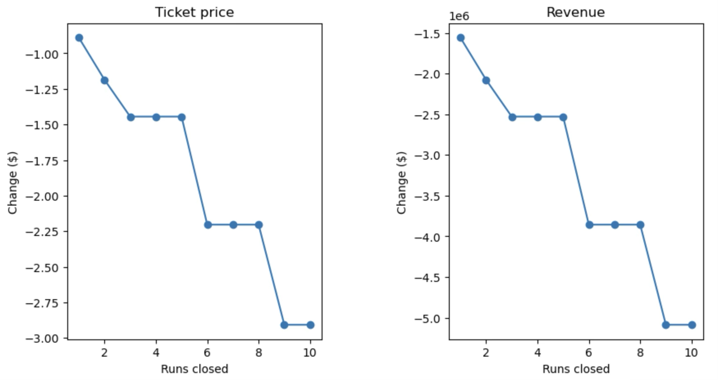
Operational Scenarios
Big Mountain Resort is considering several scenarios in addition to the ticket price increase to drive profit. Our Machine Learning Model can help with these decisions as well.
Option 1
Permanently close down up to 10 of the least used runs.
Our Model shows that closing runs will result in a reduction of ticket price. Our recommendation is this option only be considered if closing runs significantly reduces operations spending.
Option 2
Increase Vertical Drop by adding a run to a point 150 feet lower in elevation. This option requires an additional chair lift to bring skiers back up. No additional Snow Making will be added.
This option would add value by adding key features to the resort. Our Model shows that this option would add $2.22 to the ticket price, generating an estimated $3.885 Million in revenue
Option 3
Same as option 2 but adding additional snowmaking to the new run.
Our pricing model showed that this will add no value to the ticket price.
Unless Snowmaking is necessary to make the new run skiable, this option will only add costs and no potential for additional revenue.
Option 4
Increase the longest run by 0.2 miles to boast 3.5 miles length. This will require additional snow making for 4 acres.
Our pricing model showed that this will add no value. This option is not recommended because it will add no value to the resort.

Slide 8
Summary and Conclusion
Based on our data exploration and modeling, we recommend that Big Mountain Resort increase its ticket price to $97.96 as indicated by the Machine Learning Model.
For the operational scenarios, we recommend that Big Mountain Resort perform a cost analysis on Option 2. If the cost to build the additional run and chair lift plus the additional operational cost is less than the estimated revenue add ($3.885), this is the most viable option.
Next Steps
We recommend a deep dive analysis into Operating Expenses so we can further build a model that will help Big Mountain Resort make data driven decisions for daily operating strategies and future enhancements to the resort.

